Slide 1
tourGuide A tourism site
By: Adarsh Singh Tiwari & Ronak

Slide 2
Contents:
Aim of the Project
Technology Used
Modules
Snapshots

Slide 3
Aim of the project:
The Aim of this project is to make a website to provide an easy and cheap platform for people who want to travel and to explore more deep in this world.
The Outcome of this project is that a person can easily check the whole descriptions and details of any particular place.
GitHub: https://github.com/rnadarsh25/tourGuide-Web-Design-Project/tree/master/tourguide

Slide 4
Technology used:
HTML:
Hyper Text Markup Language (HTML) is the main markup language for creating web pages and other information that can be displayed in a web browser. HTML is written in the form of HTML elements consisting of tags enclosed in angle brackets (like <html>), within the web page content.
CSS:
Cascading Style Sheets (CSS) is a style sheet language used for describing the presentation semantics (the look and formatting) of a document written in a markup language.
JavaScript:
JavaScript® (often shortened to JS) is a lightweight, interpreted, object-oriented language with first-class functions, and is best known as the scripting language for Web pages, but it's used in many non-browsers as well.
JQuery:
jQuery is a lightweight, "write less, do more", JavaScript library.
The purpose of jQuery is to make it much easier to use JavaScript on your website.
jQuery takes a lot of common tasks that require many lines of JavaScript code to accomplish, and wraps them into methods that you can call with a single line of code.

Slide 5
Modules:
Home Page
tour package Page
Detail Page
Description Page
Book Ticket Page
Login Page
Hotel Page
Restaurant Page

Slide 6
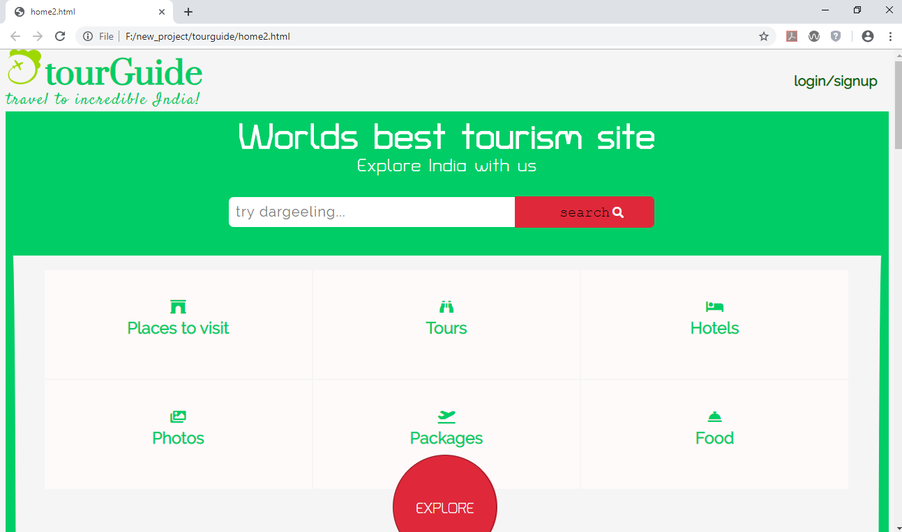
Homepage:

Slide 7
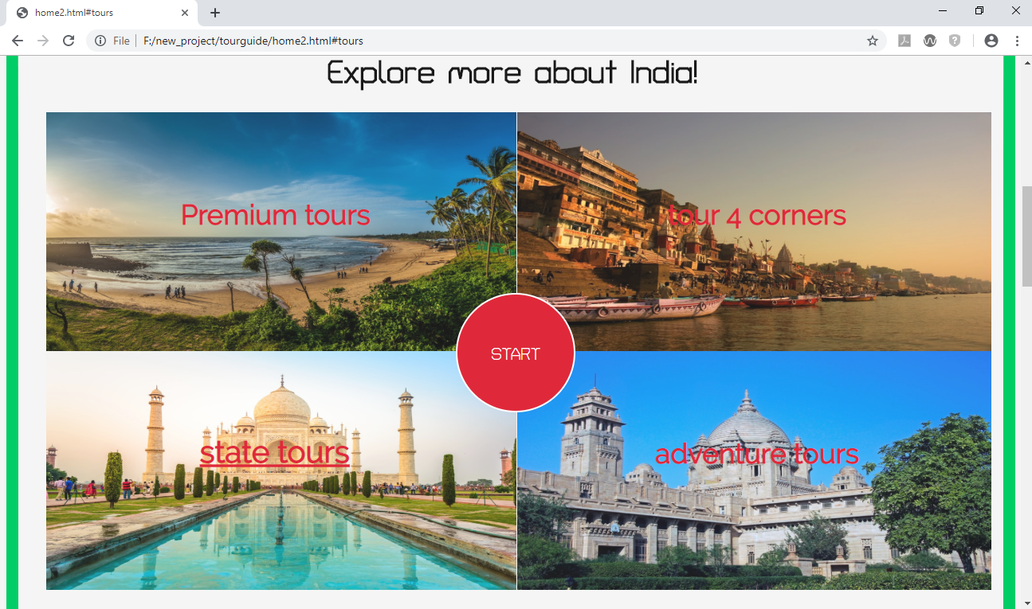
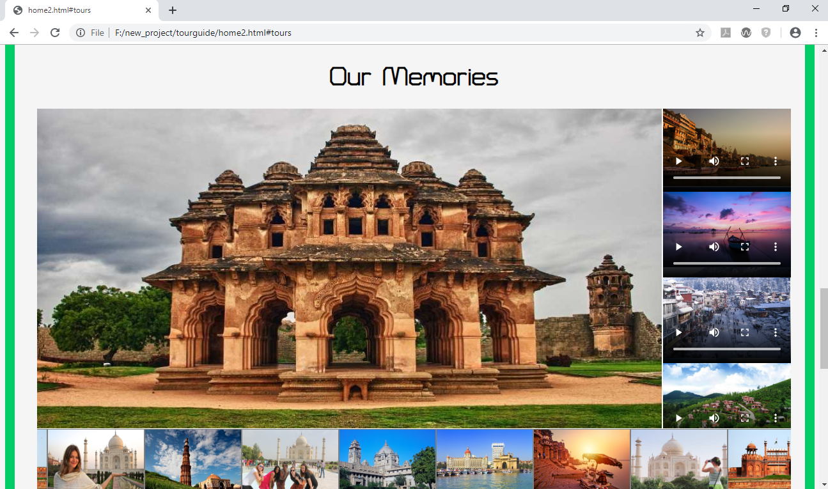

Slide 8
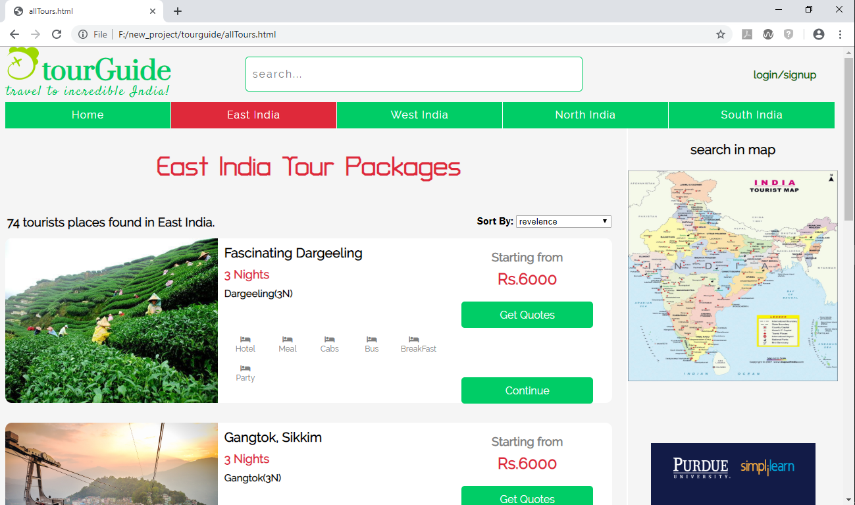
tour Package Page:

Slide 9
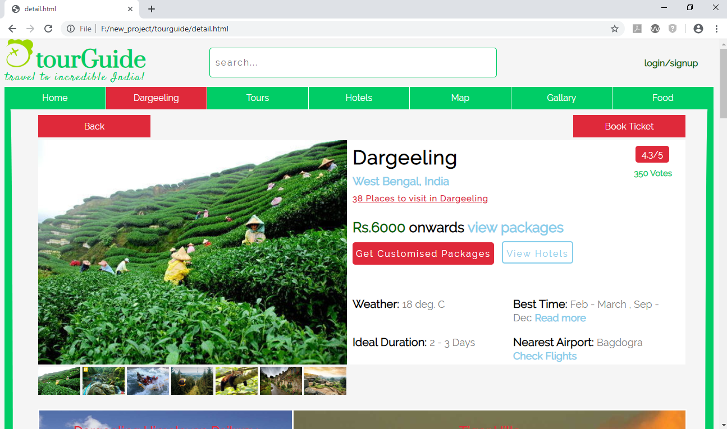
Detail Page:

Slide 10
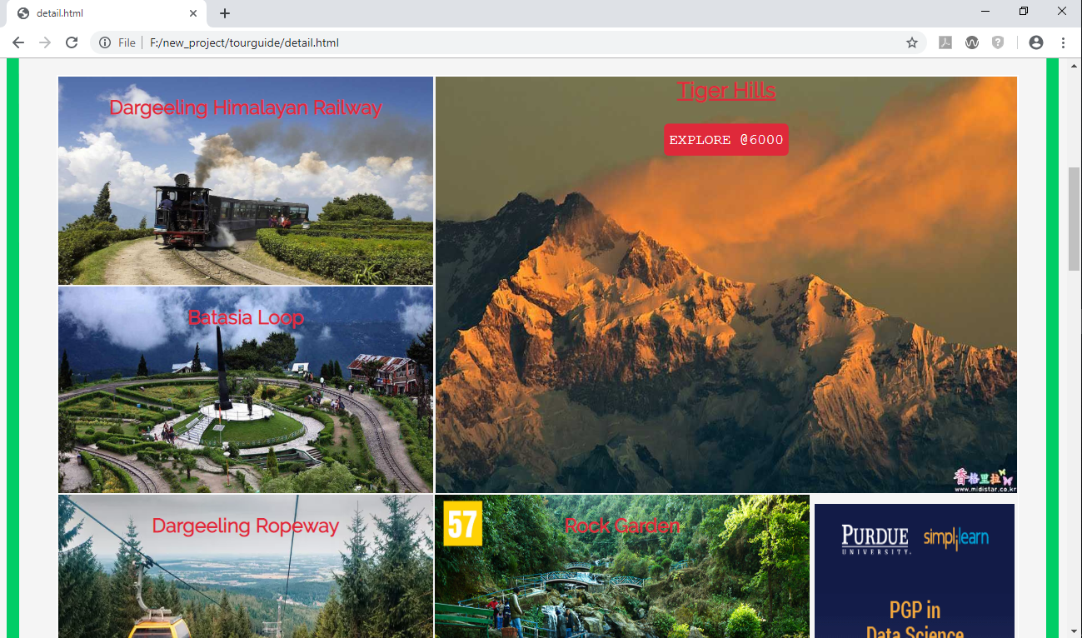
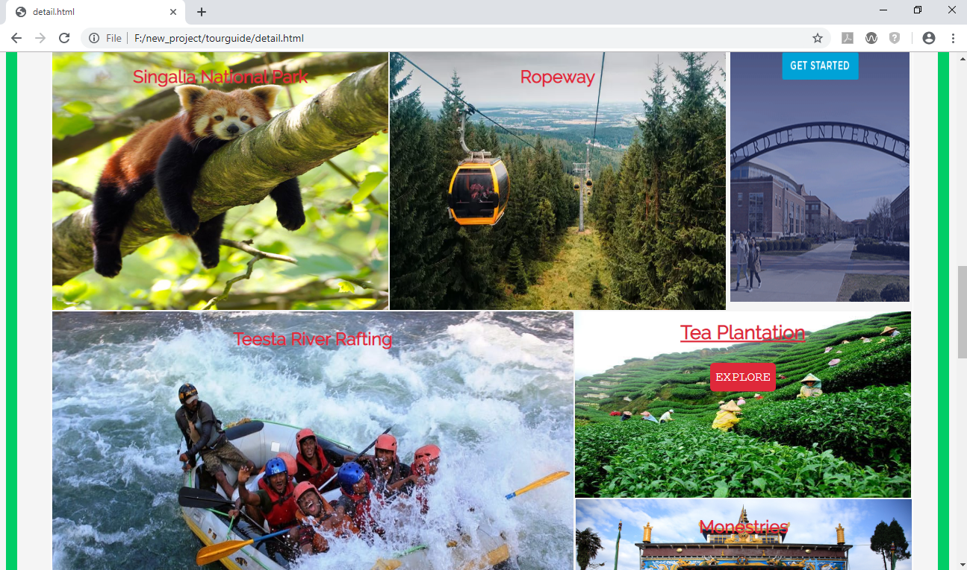
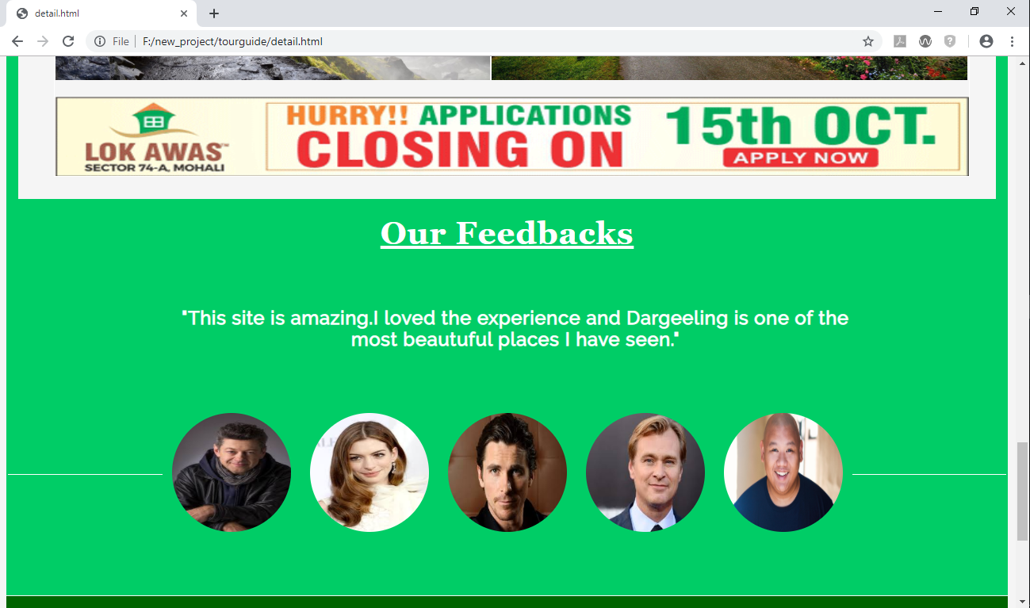

Slide 11
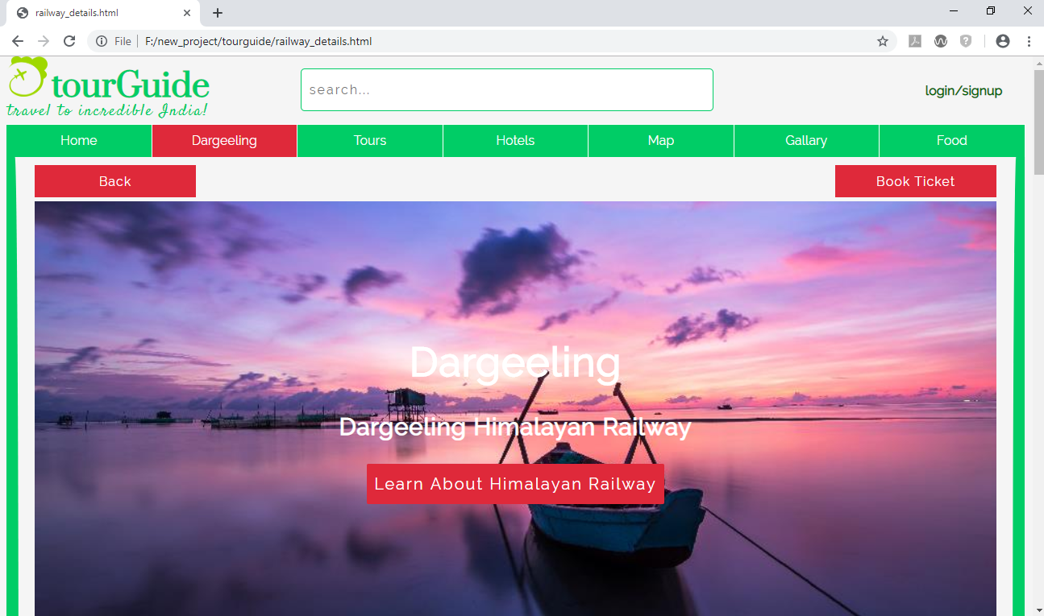
Description Page:

Slide 12
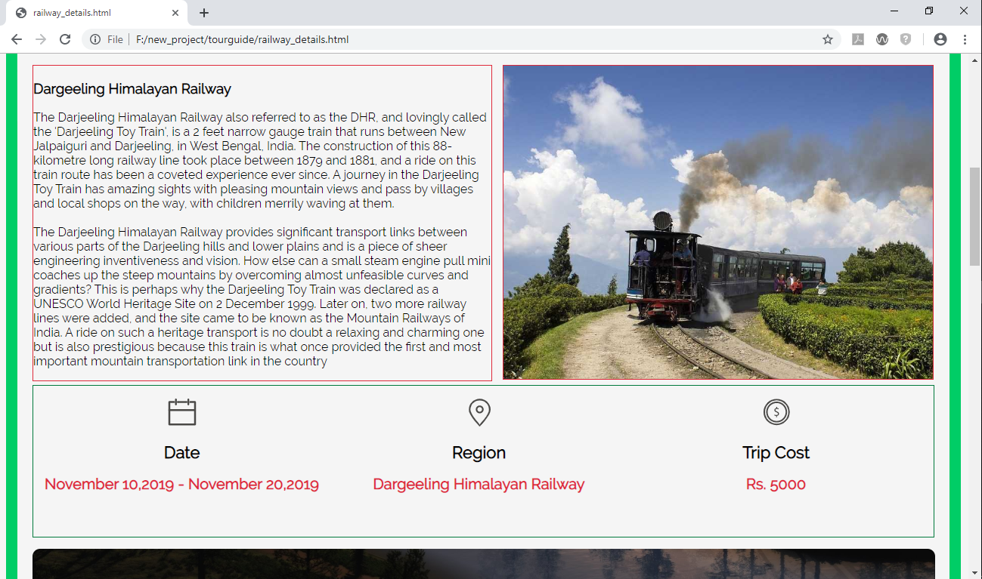
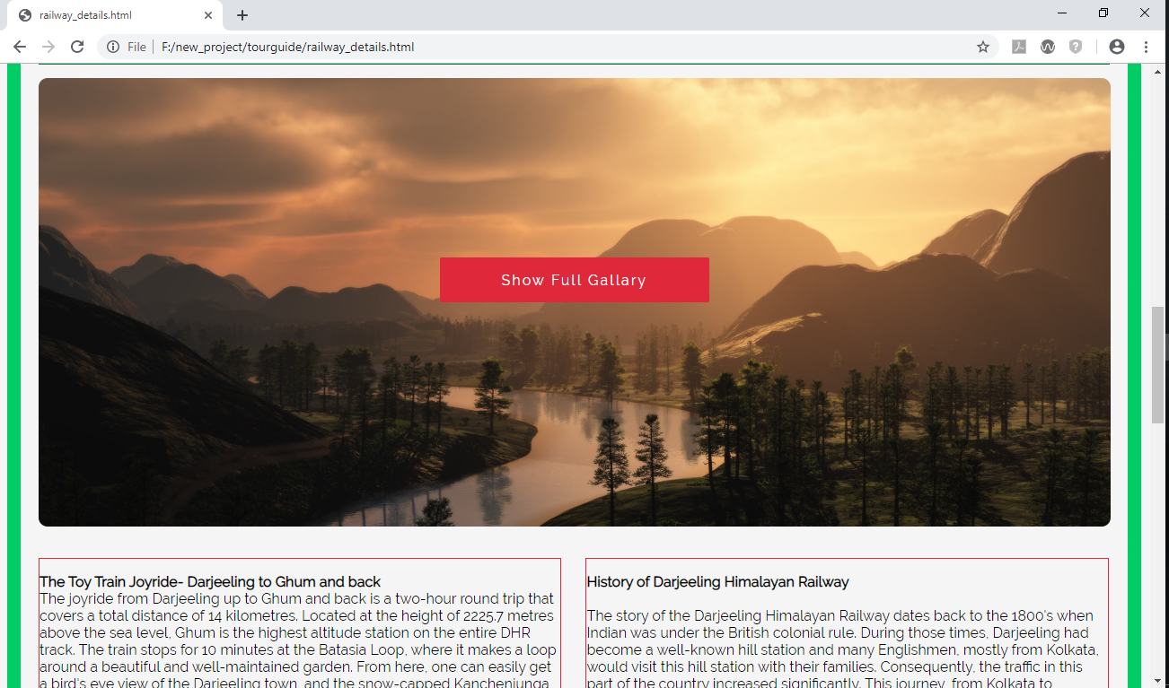
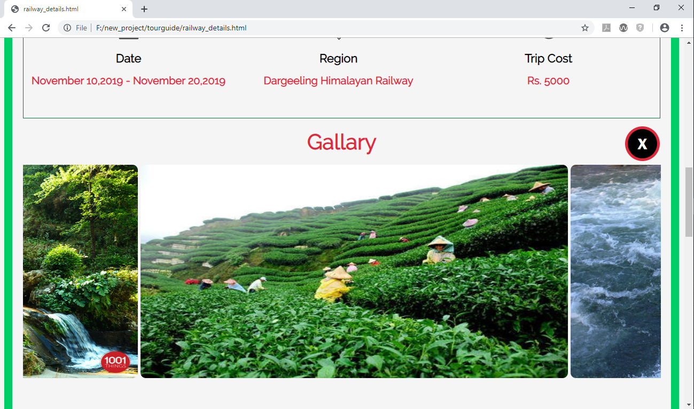

Slide 13
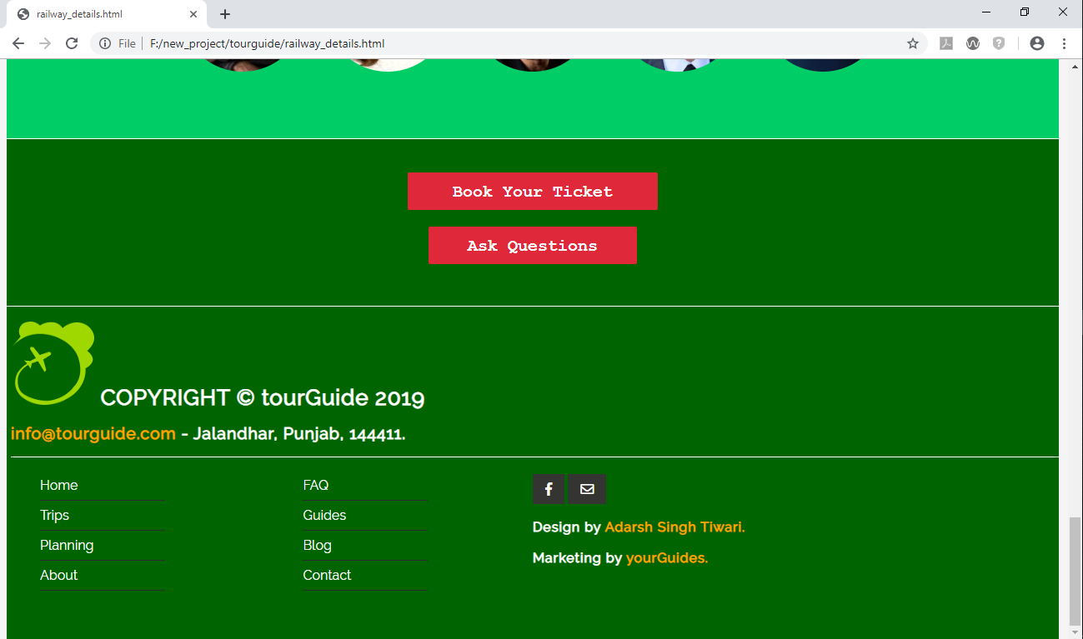

Slide 14
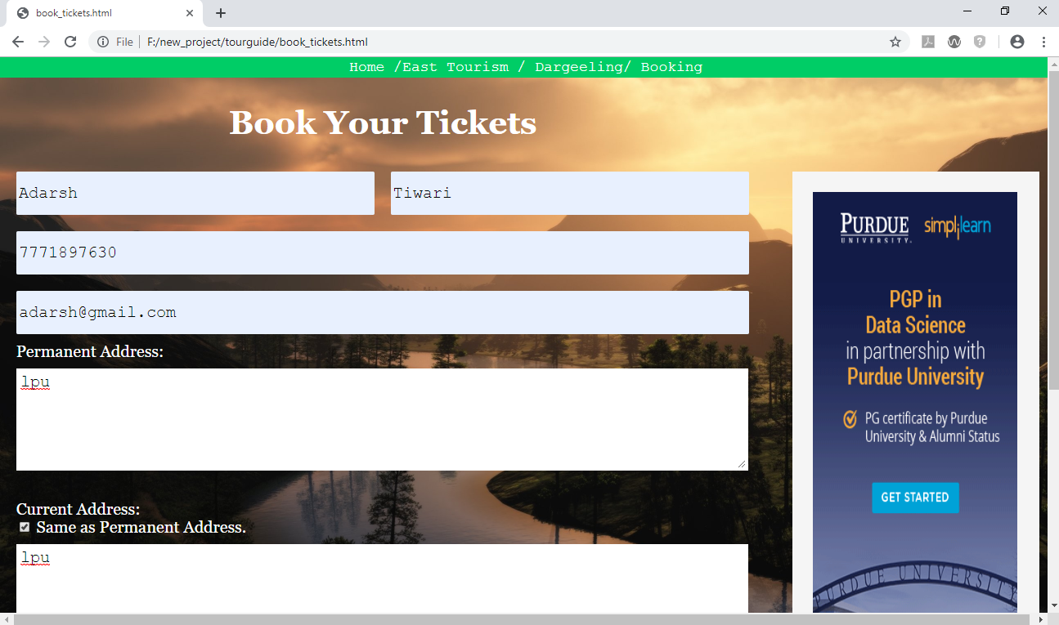
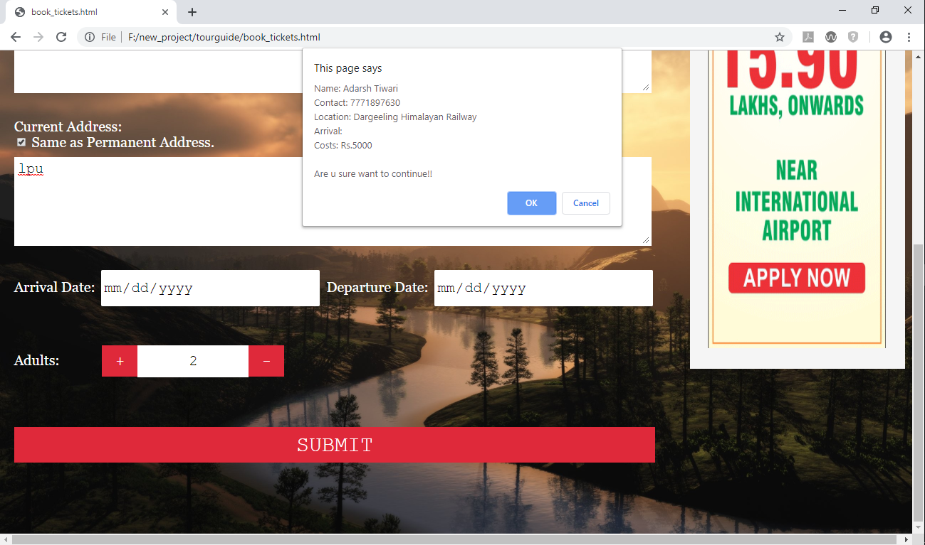
Book Ticket:

Slide 15
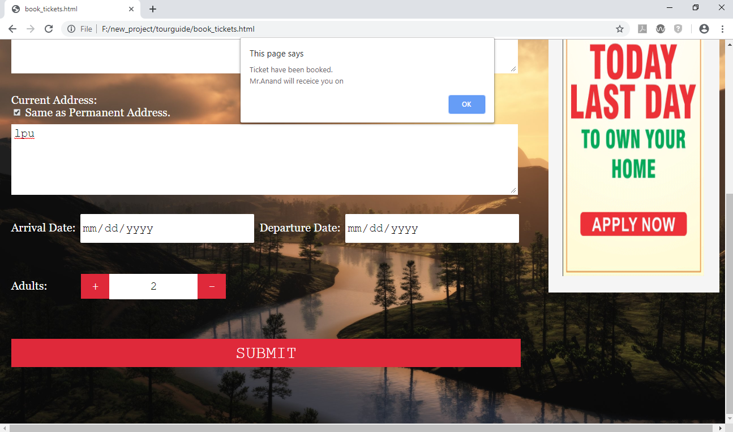

Slide 16
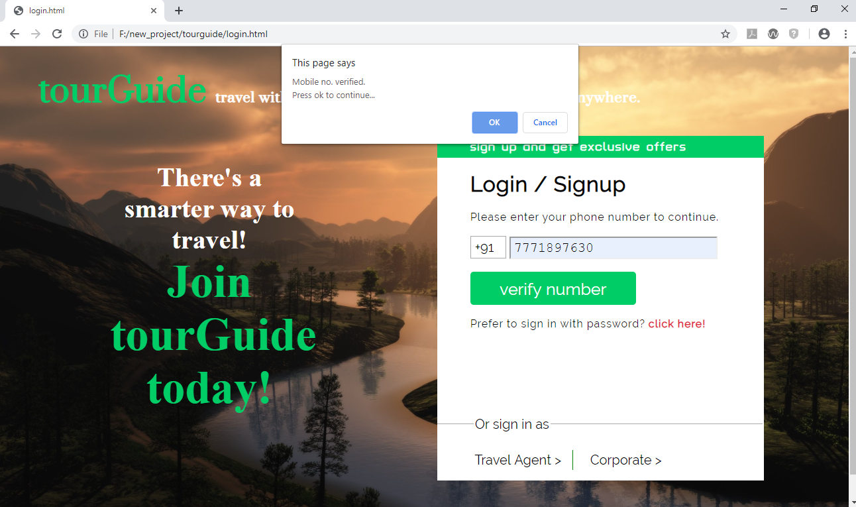
Login Page:

Slide 17
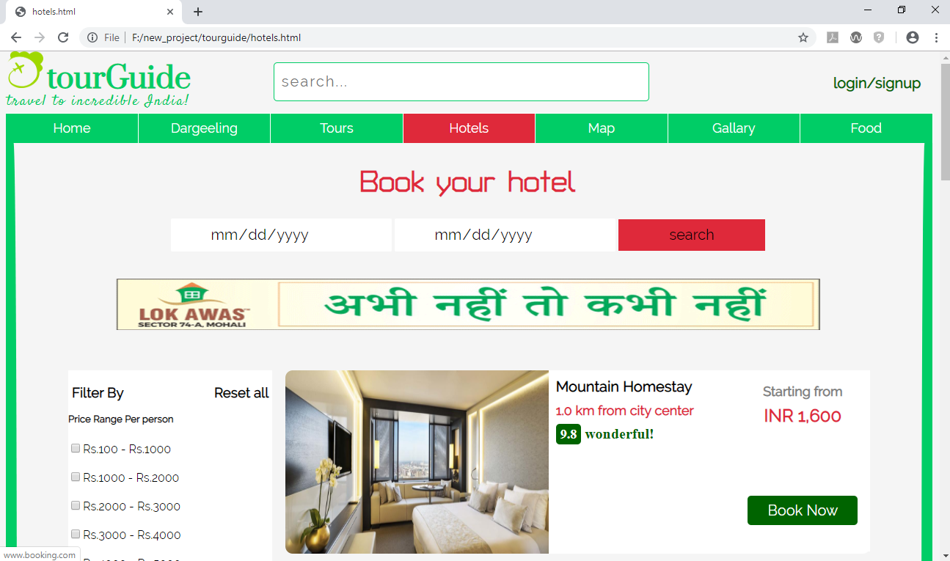
Hotel Page:

Slide 18
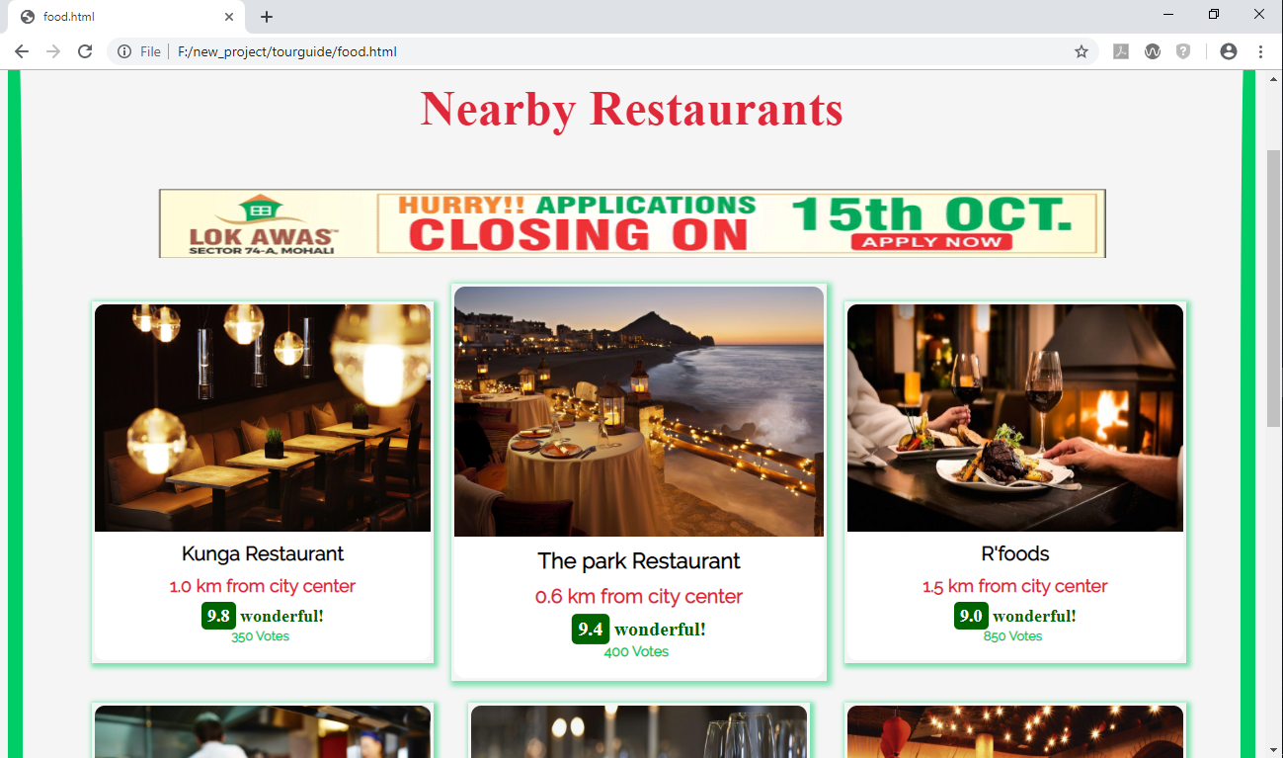
Restaurant Page:

Slide 19
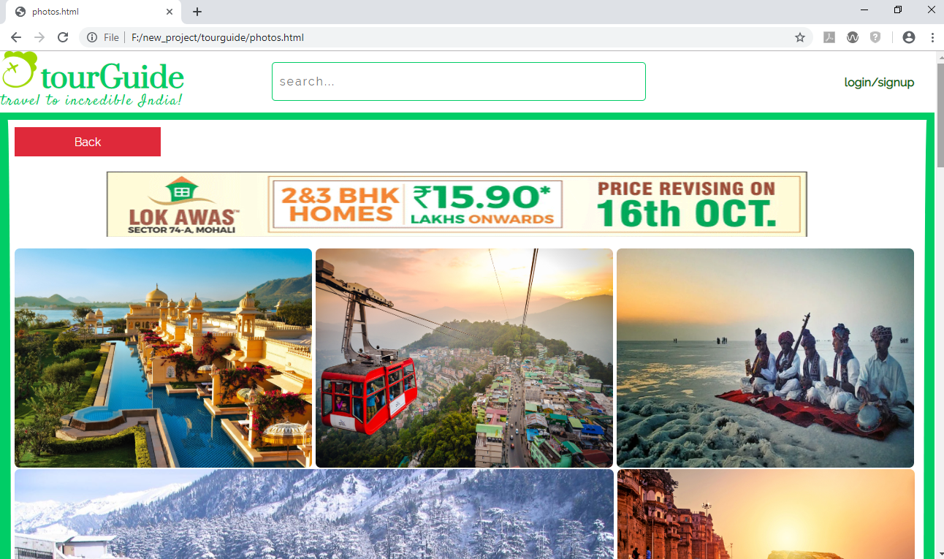
Gallery Page:

Slide 20
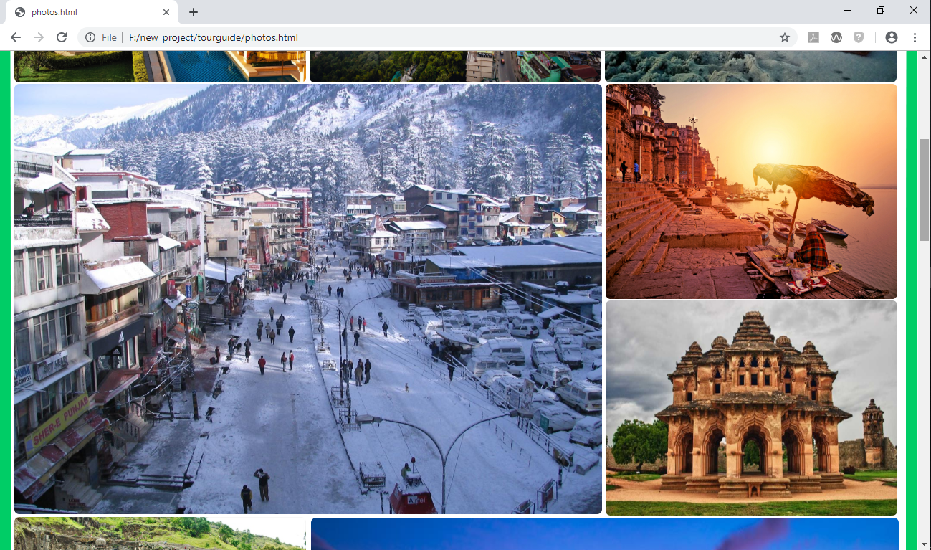
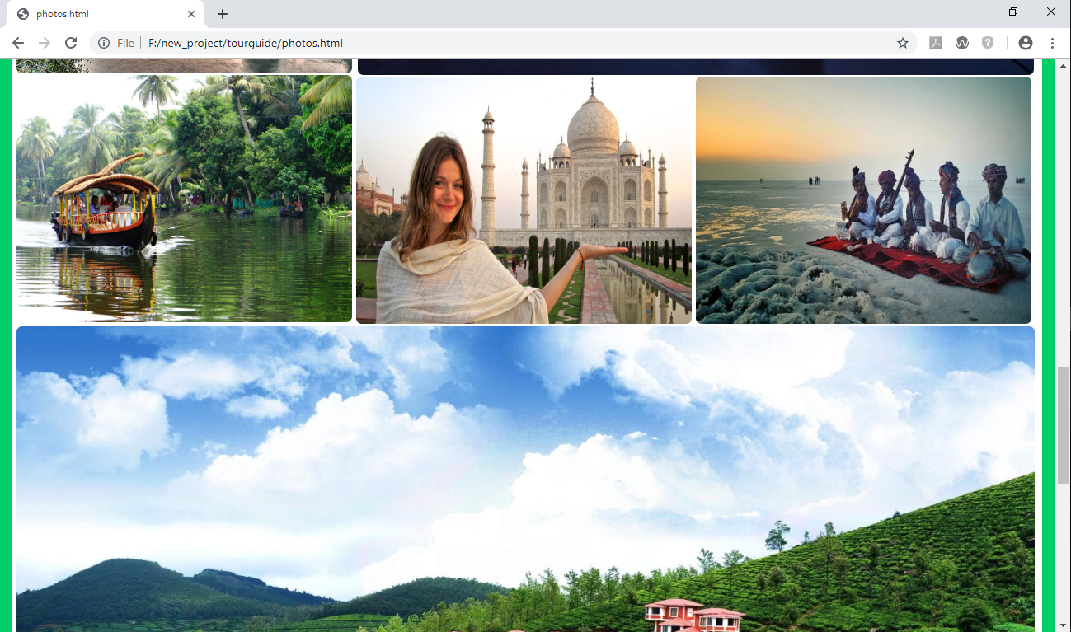
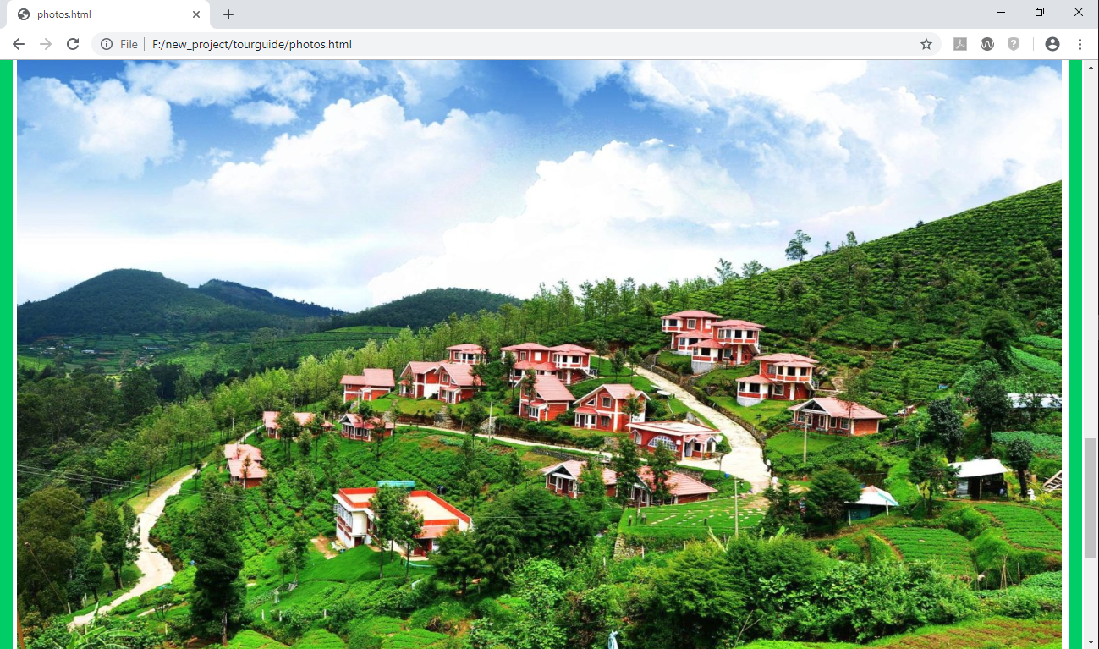

Slide 21
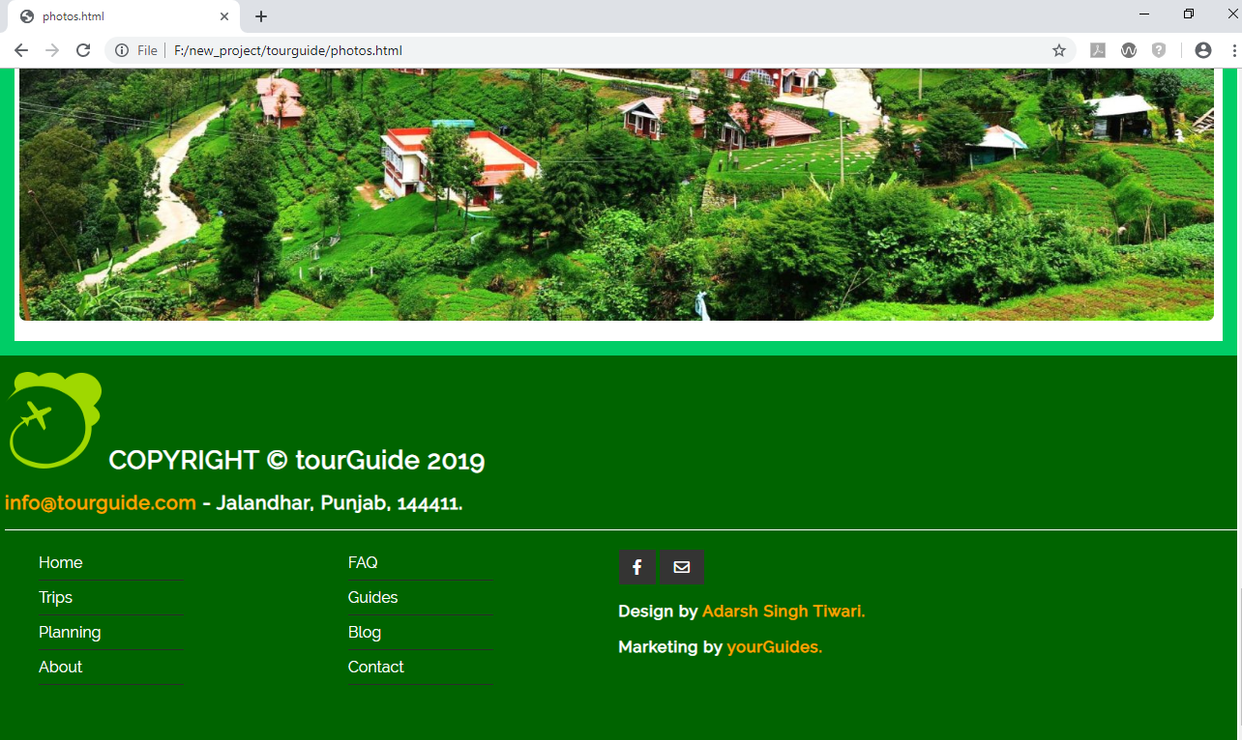
COPYRIGHT:

Slide 22
Thank You ☺
You cannot inspire others until you become your own inspiration.
-Ast.

